Slide 2
October 26, 2016

Slide 3
Accreditation
An international protocol for institutions committed to systematic and sustainable improvement
Builds capacity of the institution to improve and sustain student learning
Stimulates and improves effectiveness and efficiency throughout the institution.

Slide 4
A diagnostic process to stimulate and guide continuous improvement with a focus on:
Impact of teaching and learning
Capacity of leadership
Use of Resources
External Review

Slide 5
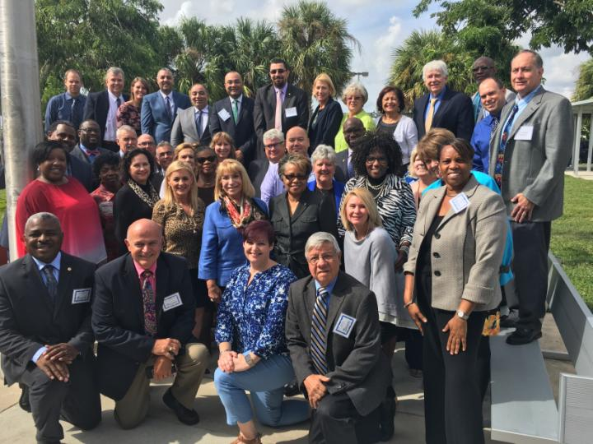
1,251 years

Slide 6
External Review: Professional judgment by the team results in:
Powerful Practices
Opportunities for Improvement
Improvement Priorities
Index of Education Quality and Accreditation Recommendation

Slide 7
Stakeholders
Stakeholder Interviews | Number
Superintendent | 1
Administrators (including Central Office) | 307
Board Members | 9
Instructional Staff | 401
Support Staff | 98
Students | 436
Parents/Community | 35
Total | 1287
Stakeholders Interviewed
Number
Director
1
Board Members
11
Administrators
62
Instructional Staff
88
Support Staff
2
Students
130
Parents/Community
45
Community
14
Central Office
45
TOTAL
397

Slide 8
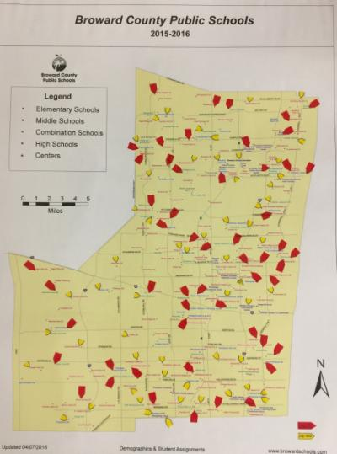

Slide 9
Balance of Centralized Direction and Local Empowerment
Defined Autonomy

Slide 10
List of Impressions
A positive culture permeates the organization built on powerful student and teacher relationships
Focus on continuous improvement and high quality teaching and learning
Transparency with respect to the issues and the results
Leadership has a laser like focus on high quality teaching and learning
Activities are provided for all students that celebrate diversity and talent

Slide 11
In the Spotlight The Findings

Slide 12
Three Domains
Teaching and Learning Impact
Standard 3: Teaching and Assessing for Learning
Standard 5: Using Results for Continuous Improvement
Student Performance Diagnostic
eleot Results
Leadership Capacity
Standard 1: Purpose and Direction
Standard 2: Governance and Leadership
Stakeholder Feedback Diagnostic
Resource Utilization
Standard 4: Resources and Support Systems

Slide 13
AdvancED
Teaching and Learning Impact
The Team Examined:
Student performance results,
Instructional quality,
Learner and family engagement,
Support services for student learning,
Curriculum quality and efficacy, and
College and career readiness data

Slide 14
ELEOT Observations
517 Observations = 172.5 hours of instruction
Environments | External Review | AEN
A. Equitable Learning Environment | 2.73 | 2.69
B. High Expectations Environment | 2.80 | 2.80
C. Supportive Learning Environment | 3.10 | 3.05
D. Active Learning Environment | 2.87 | 2.93
E. Progress Monitoring and Feedback Environment | 2.83 | 2.76
F. Well-Managed Learning Environment | 3.11 | 3.12
G. Digital Learning Environment | 1.70 | 1.86

Slide 15
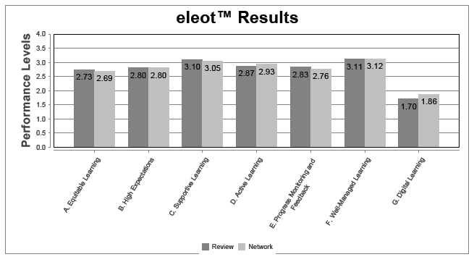

Slide 16
AdvancED
Powerful Practice
Through the reallocation of resources, the district has developed and implemented a succession planning process that acknowledges and rewards exemplary leadership and provides opportunities for building local leadership capacity at the school and system level. Standard 3.7

Slide 17
Improvement Priorities

Slide 18
AdvancED
Improvement Priority
Unify the district instructional processes to ensure the implementation of a rigorous systemic and systematic instructional framework in support of student achievement.
Standard 3.3 and 3.6

Slide 19
Opportunities for Improvement
Develop and implement a continuous program of professional learning aligned to the district’s strategic plan that includes adequate time and resources focused on interpretation, use and evaluation of data for professional and support staff.
Standard 5.3
Establish and communicate a common grading and reporting system based on clearly defined criteria that reflect the attainment of content knowledge and skills.
Standard 3.10

Slide 20
AdvancED
Leadership Capacity
The Team Examined:
Institutional purpose and direction,
Governance and leadership effectiveness,
Stakeholder engagement,
Improvement capacity, and
Results.

Slide 21
AdvancED
Powerful Practice
The Superintendent, district office leadership, and school administrators foster a culture of collaboration that supports shared leadership, innovation, and professional growth in an effort to develop high quality leadership to ultimately enhance student achievement.
Standard 2.4

Slide 22
AdvancED
Powerful Practice
The leadership has committed to a system of continuous improvement through the creation of an office dedicated to the improvement of student learning [OSPA].
Standard 1.4

Slide 23
AdvancED
Improvement Priority
Develop, implement and regularly evaluate a framework for board evaluation based on the system’s core values and in line with best practice as defined by the Florida School Board Association with the necessary professional development for quality implementation.
Standards 2.2, 2.3

Slide 24
AdvancED
Resource Utilization
The Team Examined:
Allocation and use of resources,
Equity of resource distribution to need,
Level and sustainability of resources,
Long range capital, and
Resource planning effectiveness.

Slide 25
AdvancED
Powerful Practice
Broward County Public Schools (BCPS) has secured funding in the form of a bond and grants to provide resources to support the system’s strategic plan. In a time of declining financial support, the district has aggressively pursued and obtained alternative sources of funding.
Standard 4.2

Slide 26
Accreditation is an Improvement Journey……

Slide 27
Index of Education Quality
Domains | External Review | AE Network Average
Overall Score | 275.34 | 282.79
Teaching and Learning Impact | 259.58 | 274.14
Leadership Capacity | 277.33 | 296.08
Resource Utilization | 313.72 | 286.32

Slide 28
Index of Educational Quality
275.34
100
Index of Educational Quality
400
259.58
100
Teaching and Learning Impact
Standards 3 and 5, Student Performance Evaluative Criteria
400
277.33
100
Leadership Capacity
Standards 1 and 2, Stakeholder Feedback Evaluative Criteria
400
313.72
100
Resource Utilization
Standard 4
400

Slide 29
The IEQ results indicate that the institution is performing within acceptable ranges as compared to expected criteria as well as other institutions in the AdvancED Network.

Slide 30
Questions? More Information?
The External Review Team
recommends to the
AdvancED Accreditation Commission
that the
Broward County School District
earn the distinction of
PresenterMedia.com
support@presentermedia.com
4416 S. Technology Dr
Sioux Falls, SD 57106

Slide 31
Expires
June 30, 2022

Slide 32
Improvement priorities must be addressed within two years.

Slide 33
© 2014 AdvancED
Notes:
Notes
Express your thanks and appreciation to the institution for their hospitality and their efforts toward continuous improvement.

